Slide 1
Simulation Results

Slide 2
Number | 10 | 20 | 50 | 100 | 150
Transformer(kW) | 50 | 100 | 250 | 400 | 800
MILP Time(s) | 1.010 | 1.747 | 5.725 | 7.110 | 17.634
DE Time(s) | 5.444 | 10.86 | 29.01 | 55.884 | 86.038
Charging Only Time(s) | 1.12 | 1.683 | 4.527 | 7.321 | 16.208
MILP Cost(NT) | 441.08 | 793.068 | 1806.3 | 3880.6 | 5445.1
DE Cost(NT) | 486.265 | 904.285 | 2074.7 | 4527.4 | 6471.7
Charging Only Cost(NT) | 470.73 | 838.82 | 1991 | 4480.8 | 6140.6

Slide 3
Number | 200 | 250 | 300 | 350 | 400 | 450 | 500
Transformer | 1000 | 1200 | 1400 | 1700 | 1900 | 2000 | 2000
MILP Time(s) | 19.328 | 24.133 | 29.128 | 34.520 | 41.784 | 45.848 | 51.163
DE Time(s) | 110.883 | 138.077 | 169.289 | 195.39 | 229.584 | 252.624 | 280.291
Charging Only Time(s) | 17.73 | 23.88 | 26.061 | 33.102 | 41.24 | 44.191 | 50.707
MILP Cost(NT) | 7151 | 9023.9 | 11187 | 12651 | 14271 | 16563 | 18149
DE Cost(NT) | 8701.3 | 10886 | 13304 | 15149 | 17227 | 19697 | 21911
Charging Only Cost(NT) | 8172.6 | 10485 | 12872 | 14445 | 16493 | 18932 | 21169

Slide 4

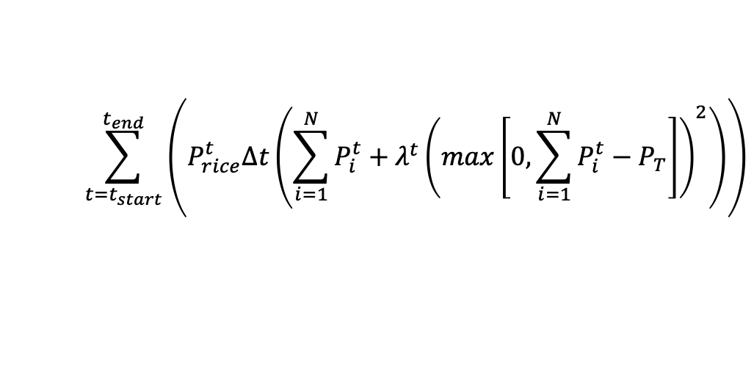



First come first served Charging
$$\sum_{t=t_{start}}^{t_{end}}{\left(P_{rice}^{t}Δt\left(\sum_{i=1}^{N}{P_{i}^{t}}+λ^{t}{\left(max\left[0,\sum_{i=1}^{N}{P_{i}^{t}}−P_{T}\right]\right)}^{2}\right)\right)}$$
Decision variable: $P_{i}^{t}$
$P_{T}:$ transformer maximum power
$N$: Total number of EVs
$λ^{t}$ penalty
First come first served scheduling
Price dependent: charge mostly at lowest price
No discharging, healthy battery
Prolonged waiting time when transformer maximum power reached

Slide 5
Case study structure
The use of Evolutionary algorithm for EVs scheduling in general
In term of speed, differential evolution leads the caravan of evolutionary algorithms
Referee: First come first served Charging
Two criteria of comparison
Algorithm speed
Achievable charging cost
Time slot 5 minutes allows rapid scheduling of new coming vehicles
Conclusion
The optimal cost obtained by DE-based algorithm is not better than that of MILP.
MILP-based smart charging algorithm is much faster than DE method, saving about 85% CPU time, which is a pivotal issue for the real-world application.

Slide 6
Number | 10 | 20 | 50 | 100 | 150
Transformer(kW) | 50 | 100 | 250 | 400 | 800
Traditional Cost(NT) | 470.73 -21.85% | 838.82 -19.26% | 1991 -17.23% | 4480.8 -15.35% | 6140.6 -21.76%
Uncoordinated | 602.3649 | 1039 | 2405.7 | 5293.5 | 7848.7
MILP Cost(NT) | 441.08 -26.77% | 793.068 -23.67% | 1806.3 -24.91% | 3880.6 -26.69% | 5445.1 -30.62%
26.7753 23.6701 24.9158 26.6912 30.6242 31.8043 31.2045 27.7699 30.2091 28.4159 27.1828 29.7422

Slide 7
Number | 200 | 250 | 300 | 350 | 400 | 450 | 500
Transformer | 1000 | 1200 | 1400 | 1700 | 1900 | 2000 | 2000
Charging Only Cost(NT) | 8172.6 -22.06% | 10485 -20.06% | 12872 -16.89% | 14445 -20.31% | 16493 -17.27% | 18932 -16.76% | 21169 -18.05% | -18.90%
Uncoordinated | 10486 | 13117 | 15488 | 18127 | 19936 | 22746 | 25832
MILP Cost(NT) | 7151 -31.80% | 9023.9 -31.20% | 11187 -27.76% | 12651 -30.20% | 14271 -28.41% | 16563 -27.18% | 18149 -29.74% | -28.25%

Slide 8
Number | 10 | 20 | 50 | 100 | 150
Transformer(kW) | 50 | 100 | 250 | 400 | 800
Charging Only Cost(NT) | 468 -22.28% | 836 -19.55% | 1987 -17.39% | 4471 -15.54% | 6129 -21.90%
Uncoordinated | 602.3649 | 1039 | 2405.7 | 5293.5 | 7848.7
DE Cost(NT) | 486.265 -19.27% | 904.285 -12.96% | 2074.7 -13.75% | 4527.4 -14.47% | 6471.7 -17.54%
Number | 200 | 250 | 300 | 350 | 400 | 450 | 500
Transformer | 1000 | 1200 | 1400 | 1700 | 1900 | 2000 | 2000
Charging Only Cost(NT) | 8171 -22.07% | 10482 -20.08% | 12870 -16.90% | 14441 -20.33% | 16492 -17.27% | 18930 -16.77% | 21161 -18.08% | -19.01%
Uncoordinated | 10486 | 13117 | 15488 | 18127 | 19936 | 22746 | 25832
DE Cost(NT) | 8701.3 -17.01% | 10886 -17.00% | 13304 -14.10% | 15149 -16.42% | 17227 -13.58% | 19697 -13.40% | 21911 -15.175% | -15.39%

